Slide 1
COMP3017 Service Computing

Slide 2

Module Two: Service Message Exchange SOAP and Service Description WSDL

Slide 3
Our textbook for this module:
Ethan Cerami, Web Services Essentials, Publisher：O’Reilly，ISBN：9780596002244，
Chapter 3 - SOAP
Chapter 6 - WSDL
Liang-Jie Zhang, Services Computing, Publisher: Springer，ISBN：9783540382812 - You can find an online version of this book for free through our library webpage.
Chapter 3.1
Chapter 3.2 (without 3.2.5)

Slide 4
Module 2 Learning Outcomes
Understand the basics of the SOAP protocol
Understand the details about the SOAP XML Message specification
Understand the SOAP encoding rules
Understand the basics of WSDL

Slide 5
Guided questions for Module 2
What is XML messaging?
What is SOAP?
What is the relationship between XML, XML-RPC, and SOAP?
What is advantage of SOAP over CORBA, DCOM, and Java RMI?
What platform and language do we need to use with SOAP? (tricky question)
What are the major parts in SOAP specification?
What are the main SOAP encoding rules?

Slide 6
Guided questions for Module 2
What is WSDL?
What is the relationship between WSDL and service description?
What data does WSDL describe?
What is WSDL used for?
What platform and language do we need to use with WSDL? (tricky question)
What are the major elements of WSDL?
What is the relationship between SOAP, WSDL, and UDDI?

Slide 7
Review

Slide 8
Web Service Protocol Stack
Searching / Publishing Web Services
Discovery UDDI
Description WSDL
Describing Web Services interface
XML Messaging XML-RPC, SOAP,XML
Transport HTTP,SMTP,FTP, BEEP
Encoding messages in XML format
Transporting XML messages between client and server
8

Slide 9
WSDL - a standard for describing Web Services
Credit Card
Credit Card
Web Service Description
Hotel
Hotel
Web Service Description
Travel Agency 1
Web Service Description
Travel Agency 1
Airline
Airline
Web Service Description
Client App
A client program connecting to a Web service can read the WSDL file to determine what operations are available on the server

Slide 10
SOAP - a standard for accessing Web Services
Credit Card
Hotel
INVOKE
INVOKE
Travel Agency 1
INVOKE
Airline
INVOKE
Client App
Service requestor uses SOAP to call one of the operations listed in the WSDL file

Slide 11
SOAP uses
B2B – Business to Business
EAI - Enterprise application integration

Slide 12
B2B using SOAP

Slide 13
EAI using SOAP

Slide 14
SOAP message example

Slide 15
SOAP Message - elements
Mandatory elements
Envelope element
Body element
Optional elements
Header element
Fault element
Each of these elements has an associated set of rules

Slide 16
SOAP characteristics
Extensibility
Neutrality
SOAP can operate over any protocol such as HTTP, SMTP, TCP, UDP,…
Independence
SOAP allows for any programming model

Slide 17
Extensibility
SOAP provides a messaging framework only.
However, it can be extended to add features such as reliability, security etc.
There are rules to be followed when adding features to the SOAP framework

Slide 18
Alternatives to SOAP Web services
REST
JSON

Slide 19
Service Description WSDL

Slide 20
Web Service Protocol Stack
Discovery UDDI
Description WSDL
Describing Web Services interface
XML Messaging XML-RPC, SOAP,XML
Transport HTTP,SMTP,FTP, BEEP
20

Slide 21
Using the Protocols Together – service provider perspective
Step 1:
Create core functionality
Step 2:
Create an XML-RPC or SOAP service wrapper
Step 3:
Create WSDL service description
or XML-RPC integration instructions
Step 4:
Deploy service
Step 5:
Register new service via UDDI

Slide 22
Using the Protocols Together – service request perspective
Step 1:
Find Services via UDDI
Step 2:
Retrieve Service Description File:
WSDL or XML-RPC Instructions
Step 3:
Create XML-RPC or SOAP Client
Step 4:
Invoke Remote Service
A client program reads a WSDL document to understand what a Web service can do; then it uses SOAP to actually invoke the functions listed in the WSDL document.

Slide 23
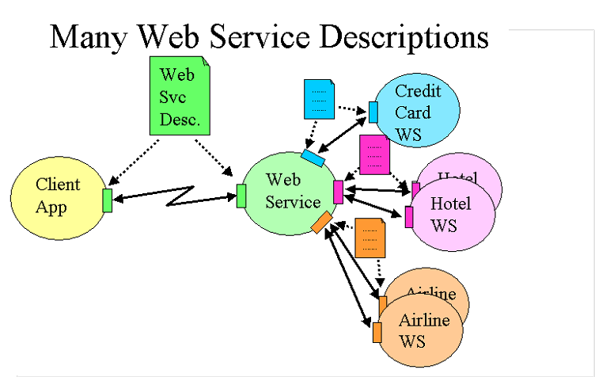
WSDL Essentials
For services to interact, they must be aware of each other

Slide 24
Service Description
WSDL provides a notation to answer the following three questions:
What is the service about?
Where does it reside?
How can it be invoked? (i.e., what, where, and how)

Slide 25
What is WSDL
WSDL is a specification defining how to describe web services in a common XML grammar.
WSDL describes four critical pieces of data:
Interface information describing all publicly available functions
Data type information for all message requests and message responses
Binding information about the transport protocol to be used
Address information for locating the specified service

Slide 26
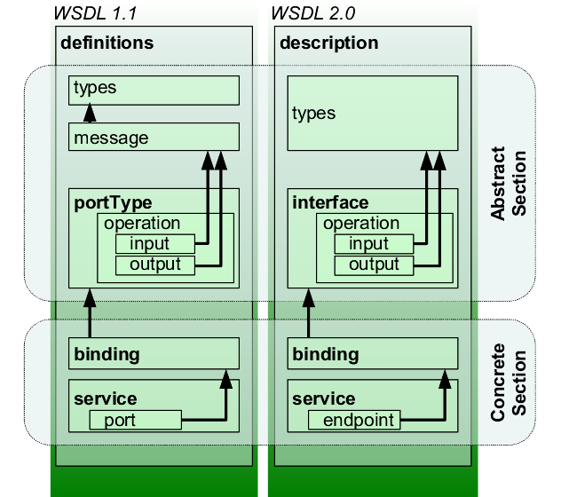
WSDL
An XML-based interface description language
Used for describing the functionality offered by a web service
WSDL describes services as collections of network endpoints or ports

Slide 27
WSDL
An XML-based interface description language
Used for describing the functionality offered by a web service
WSDL describes services as collections of network endpoints or ports

Slide 28
WSDL Specification major Elements
definitions
types
message
portType
binding
service

Slide 29
WSDL Specification major Elements
definitions
types
message
portType
binding
service

Slide 30
WSDL Specification utility Elements
documentation
The documentation element is used to provide human-readable documentation and can be included inside any other WSDL element
import
The import element is used to import other WSDL documents or XML Schemas.
This enables more modular WSDL documents. For example, two WSDL documents can import the same basic elements and yet include their own service elements to make the same service available at two physical addresses.

Slide 31
Example - HelloService.wsdl
The service provides a single publicly available function, called sayHello.
The function expects a single string parameter
The function returns a single string greeting.
For example, if you pass the parameter world, the service returns the greeting: "Hello, world!"

Slide 33
What massages will be transmitted?

Slide 34
What data types will be transmitted?

Slide 35
What functions will be supported?

Slide 36
How will the messages be transmitted?

Slide 37
Where is the service located?

Slide 38
Interoperability
Ability of services to connect and communicate with one another

Slide 39

Open Question
Points: 10
How does WSDL help achieve interoperability?
Open Question is only supported on Version 2.0 or newer.
Answer

Slide 40
WSDL file is what binds everything together
WSDL file is written in XML
XML can be read by any programming language
Both .Net and Java have corresponding commands that have the ability to work with XML
If the client application was written in .Net – it would understand the XML file
If the client app was written in Java – it could also interpret the WSDL file

Slide 41
WSDL file is what binds everything together
WSDL file is written in XML
XML can be read by any programming language
Both .Net and Java have corresponding commands that have the ability to work with XML
If the client application was written in .Net – it would understand the XML file
If the client app was written in Java – it could also interpret the WSDL file
Web services allow multiple applications built on various programming languages to talk to each other
We can have a .Net web application talking to a Java application via a Web service

Slide 42
Web Services Interoperability benefits
Facilitate B2B collaboration
Each organization exposes its business applications as services on the Internet and makes them accessible via standard programming interfaces
Facilitate distributed computing and resource sharing over the Internet
Cross-language and cross-platform
Cost effective way to quickly develop and deploy Web applications
Integrate other independently published Web service components into new business processes

Slide 43
Developing Web Services with WSDL

Slide 44
Does a Web Service need to be developed from scratch?
Any existing application can become a Web Service as long as it is wrapped by a Web Services interface (WSDL) and then published in a registry.

Slide 45
What if we do want to develop the web service from scratch?
Start by modelling its potential interfaces before moving to implementation details
Widget, Inc
Purchase Orders
Client App

Slide 46
Application Design
46
Web service is defined in WSDL
Top-down
WSDL is created (or found) first before its implementation
Bottom-up
WSDL gets generated from existing JEE components
Middle-ground

Slide 47
Web Services Toolkits
Service Implementation
SOAP
manually
supply method
code
invoke a web service through SOAP request & response msgs
generate WSDL from web service code
Service
Implementation Skeleton
Client
WSDL
generate server implementation code
generate client proxy code for accessing a web service
47
Notes:
47
Much of this user's guide assumes you already have the implementation written, and are using the Web Service Builder to transform that existing application into a Web service. However, if you wish to create a new implementation for an existing Web service, the Web Service Builder can generate skeleton service code that you can use as a basis to develop a new implementation.
+ skeleton generated (WORD file)
A proxy class for a given service is typically created from its WSDL document
Once you write and deploy a WebMethod, clients need to know exactly what the SOAP messages need to look like in order to successfully communicate with it. The standard way to provide Web service descriptions is through WSDL (and embedded XSD definitions). To help accommodate this, the .asmx handler automatically generates both a human readable documentation page along with a WSDL definition that accurately reflects the WebMethod interface. If you've applied a bunch of mapping attributes to your WebMethods, they're all reflected in the generated documentation.

Slide 48
End of review

Slide 49
Service reusability
Service reuse is often mentioned as an important aspect of SOA
The aim is to create services that can be reused across a business
Does WSDL help with reusability?

Slide 50
WSDL and reusability
Recall the sections of WSDL document. How do you think WSDL helps with reusability of services?

Slide 51
WSDL
Web service is described as a set of communication endpoints (ports)

Slide 52
WSDL
Endpoint is made of two parts
Abstract definitions of operations and messages
Concrete binding to networking protocol (and corresponding endpoint address) and message encoding

Slide 53
WSDL Authoring Style Recommendation
Abstract and concrete portions of WSDL description are often defined in two or more files
Concrete file imports the abstract one
Why this separation?
Enhance reusability

Slide 54
WSDL Authoring Style Recommendation
To enhance Reusability and maintainability
Maintain WSDL document in 3 separate parts
– Data type definitions
– Abstract definitions
– Specific service bindings
Use “import” element to import necessary part of WSDL document

Slide 55
Example
Earlier, we have seen an example where a WSDL description was maintained as one file
Next, we will study an example where a WSDL description is maintained in three files

Slide 56
Example – to enhance reusability and maintainability
3 files instead of 1
Maintain WSDL document in 3 separate parts
– Data type definitions
http://example.com/stockquote/stockquote.xsd
– Abstract definitions
http://example.com/stockquote/stockquote.wsdl
– Specific service bindings
http://example.com/stockquote/stockquoteservice.wsdl
Use “import” element to import necessary part of WSDL document

Slide 57
http://example.com/stockquote/stockquote.xsd
<?xml version="1.0"?>
<schema targetNamespace="http://example.com/stockquote/schemas"
xmlns="http://www.w3.org/2000/10/XMLSchema">
<element name="TradePriceRequest">
<complexType>
<all>
<element name="tickerSymbol" type="string"/>
</all>
</complexType>
</element>
<element name="TradePrice">
<complexType>
<all>
<element name="price" type="float"/>
</all>
</complexType>
</element>
</schema>
Maintain WSDL document in 3 separate parts
– Data type definitions
– Abstract definitions
– Specific service bindings

Slide 58
http://example.com/stockquote/stockquote.wsdl
<?xml version="1.0"?>
<definitions name="StockQuote"
targetNamespace="http://example.com/stockquote/definitions"
xmlns:tns="http://example.com/stockquote/definitions"
xmlns:xsd1="http://example.com/stockquote/schemas"
xmlns:soap="http://schemas.xmlsoap.org/wsdl/soap/"
xmlns="http://schemas.xmlsoap.org/wsdl/">
<import namespace="http://example.com/stockquote/schemas"
location="http://example.com/stockquote/stockquote.xsd"/>
Use “import” element to import necessary part of WSDL document

Slide 59
Abstract part
<message name="GetLastTradePriceInput">
<part name="body" element="xsd1:TradePriceRequest"/>
</message>
<message name="GetLastTradePriceOutput">
<part name="body" element="xsd1:TradePrice"/>
</message>
<portType name="StockQuotePortType">
<operation name="GetLastTradePrice">
<input message="tns:GetLastTradePriceInput"/>
<output message="tns:GetLastTradePriceOutput"/>
</operation>
</portType>
</definitions>
Maintain WSDL document in 3 separate parts
– Data type definitions
– Abstract definitions
– Specific service bindings

Slide 60
http://example.com/stockquote/stockquoteservice.wsdl
<?xml version="1.0"?>
<definitions name="StockQuote"
targetNamespace="http://example.com/stockquote/service"
xmlns:tns="http://example.com/stockquote/service"
xmlns:soap="http://schemas.xmlsoap.org/wsdl/soap/"
xmlns:defs="http://example.com/stockquote/definitions"
xmlns="http://schemas.xmlsoap.org/wsdl/">
<import namespace="http://example.com/stockquote/definitions"
location="http://example.com/stockquote/stockquote.wsdl"/>
<binding name="StockQuoteSoapBinding“ type="defs:StockQuotePortType">
<soap:binding style="document" transport="http://schemas.xmlsoap.org/soap/http"/>
<operation name="GetLastTradePrice">
Use “import” element to import necessary part of WSDL document

Slide 61
Concrete part – specific service bindings
<soap:operation soapAction="http://example.com/GetLastTradePrice"/>
<input><soap:body use="literal"/> </input>
<output><soap:body use="literal"/></output>
</operation>
</binding>
<service name="StockQuoteService">
<documentation>My first service</documentation>
<port name="StockQuotePort" binding="tns:StockQuoteBinding">
<soap:address location="http://example.com/stockquote"/>
</port>
</service>
Maintain WSDL document in 3 separate parts
– Data type definitions
– Abstract definitions
– Specific service bindings

Slide 62
Example – to enhance reusability and maintainability
3 files instead of 1
Maintain WSDL document in 3 separate parts
– Data type definitions
http://example.com/stockquote/stockquote.xsd
– Abstract definitions
http://example.com/stockquote/stockquote.wsdl
– Specific service bindings
http://example.com/stockquote/stockquoteservice.wsdl
Use “import” element to import necessary part of WSDL document

Slide 63
WSDL

Slide 64
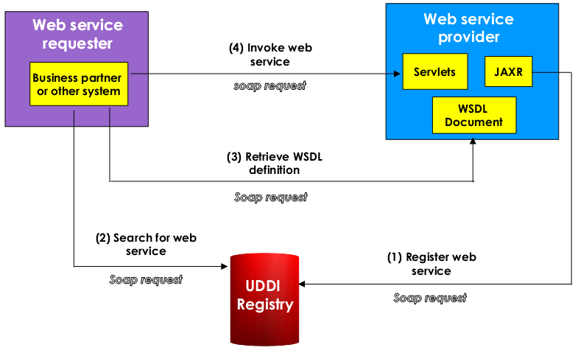
Where are SOAP annd WSDL Used?
64

Slide 65
Module 2 Summary
SOAP technology
WSDL technology

